Slide 1
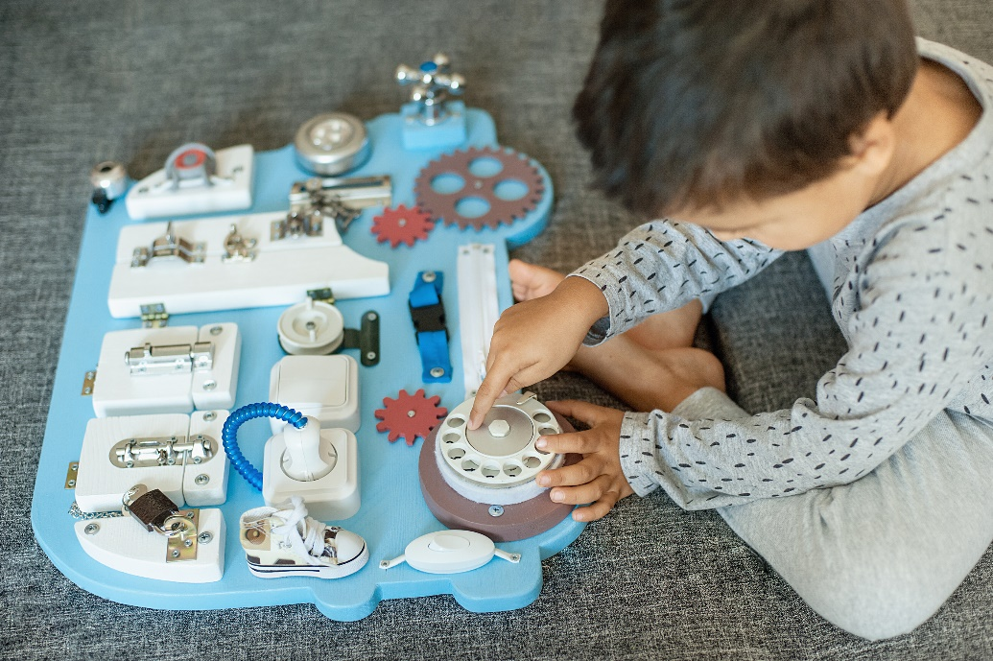
GUI Widgets
Label, ComboBox, Button
Entry, Text
Checkbutton
Radiobutton
Menus
Notes:
In this lesson we’ll look at several GUI widgets.
Widgets are the controls that users interact with on your GUI. A widget is something that a user clicks or tugs or types on or drags around.
We’ll build up our sample application using LABEL, COMBOBOX, BUTTON, ENTRY, and TEXT.
We’ll look at CHECKBUTTONs and RADIOBUTTONs.
And we’ll look at how to add nested menus to your GUI application.

Slide 2
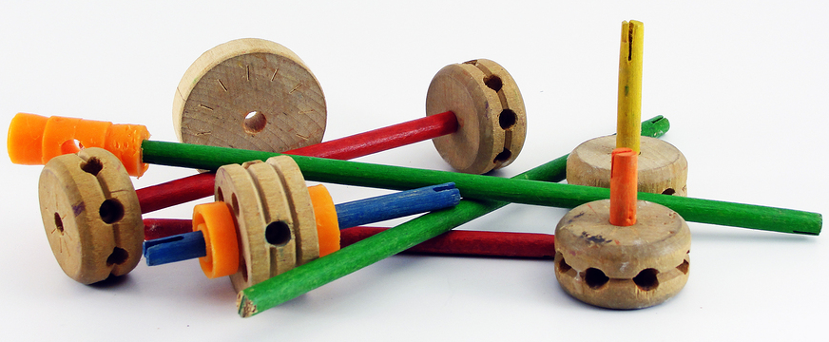
See Also
https://docs.python.org/2/library/ttk.html
http://www.tkdocs.com/tutorial/widgets.html
Notes:
Here is some additional reading on the web

Slide 3
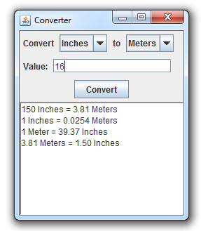

Example Application
Label
ComboBox
Entry
Button
Text
Notes:
We can explore different widgets by building our CONVERTER application.
@1 We’ll need three LABEL widgets
@2 There are two COMBOBOX widgets to pick the to and from units
@3 This is a single ENTRY for the user to type in the value to convert
@4 Then the BUTTON to start the conversion
@5 And a readonly TEXT widget to store the output history

Slide 4
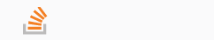
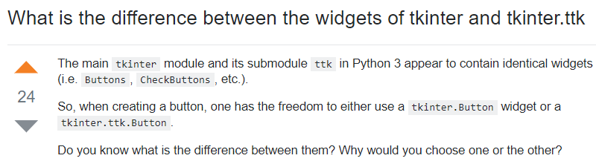
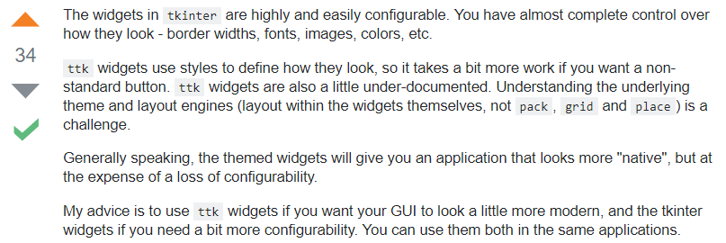
Tkinter and ttk
stackoverflow.com
Notes:
You quickly notice that there are two sets of GUI widgets you can choose from when you are using Tkinter.
For instance, you can use the BUTTON widget in the TKINTER module or you can use the button widget in the TTK submodule beneath TKINTER.
@1 Why are there two different sets of widgets? Great question! And someone asked it concisely on StackOverflow back in 2013.
I up-voted the answer. In short – the TTK widgets have been styled OR THEMED so that applications that use them look like other applications on the OS. TTK buttons are rounder on the MAC than they are on Windows. They look the way MAC users would expect.
@3 His advice is pretty sound. READ IT. And we’ll use both in our example here.

Slide 5
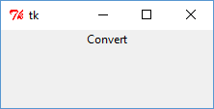
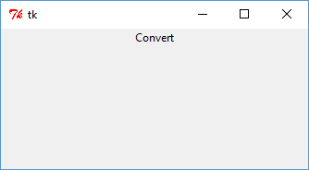
Label
import tkinter
from tkinter import ttk
top = tkinter.Tk()
m1 = ttk.Label(top, text="Convert")
m1.pack()
top.mainloop()
Top most Frame
This child’s parent
Default: new row beneath previous child, centered on row.
Main UI loop. This never returns.
Streams of bytes … two ways (into your program and out of your program)
Disks, consoles, sockets, keyboards, printers
Know how to talk streams and you can talk to anything
Initialization (constructor) is different. Use is the same.
Notes:
GUI applications start with a top level container.
@1 Here we create the TK object
@2 This is the application’s window – it’s top most Frame. We’ll add other widgets to this Frame.
@3 We have to import Tkinter before we use it
Now to create a LABEL object.
@4 We’ll use the LABEL from the ttk module. @5 and we have to import that module.
@6 The first argument to the constructor is the parent container. Here we are adding the new LABEL to the top frame. There are many named parameters you can pass to label. Here we’ll just pass the text.
@7 We need to tell the layout manager where to put the new component. We’ll talk about layout managers in the next lesson. There are arguments you can pass to PACK to control the layout,
@8 but the default is add the component on a new row beneath the previous widget … and to keep the widget centered on that row.
@9 We are through creating the widgets and adding callbacks. We don’t have any callbacks yet … this will be a boring application. We call “mainloop” on the top level frame.
@10 This method never returns so don’t put any code after it! The mainloop draws the GUI and handles user inputs. This loop runs until you kill the program.
@11 And on the screen … there is our first GUI application. Not much you can do besides close it with the X.
@12 Well you can resize it. Notice how the LABEL remains packed against the top of the frame – and centered on the screen.
Press X to kill the main loop and return to your code here. Presumably that’s the last line in your program so the program comes to an end.

Slide 6
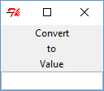
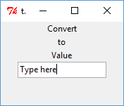
Entry
import tkinter
from tkinter import ttk
top = tkinter.Tk()
m1 = ttk.Label(top, text="Convert")
m1.pack()
m2 = ttk.Label(top, text="to")
m2.pack()
m3 = ttk.Label(top, text="Value")
m3.pack()
inp = ttk.Entry(top)
inp.pack()
top.mainloop()
Notes:
Let’s make all three labels for our converter application.
@1 We already did CONVERT
@2 For now let’s put TO right below it
@3 And VALUE right below that
@4 Now for the user’s input .. An ENTRY widget, also from TTK.
The first argument is the parent container – again the top where we put the labels. There are other parameters you can pass here. I’ll let you google and experiment with those on your own. This is all we need for our application.
@5 And we pack it in right below the other components … centered on the line.
Run it @6 and there are our 4 widgets. Three labels and an entry – packed on after the other. The default packing is one below the other …
@7 And they stay centered when we resize the window

Slide 7
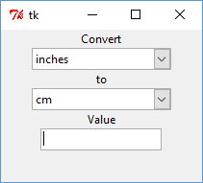
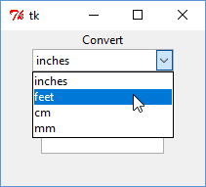
ComboBox
m1 = ttk.Label(top, text="Convert")
m1.pack()
c1 = ttk.Combobox(top, values=["inches","feet","cm","mm"])
c1.set("inches")
c1.pack()
m2 = ttk.Label(top, text="to")
m2.pack()
c2 = ttk.Combobox(top, values=["inches","feet","cm","mm"])
c2.set("cm")
c2.pack()
Notes:
Now for the combo boxes. We’ll insert those here after their respective labels.
@1 Again from TTK … the COMBOBOX. Parent container, and we’ll pass in the VALUES argument. This is an array of strings to show in the drop down.
@2 This sets the value of the COMBO box to INCHES. The box starts out with this value selected.
@3 Pack it in there right below the label
@4 Same with the FROM combo box. Here we’ll select CM to start with.
@5 Run the code. Now the application is a little more interesting.
@6 We can click on the dropdown arrow and select new values.

Slide 8
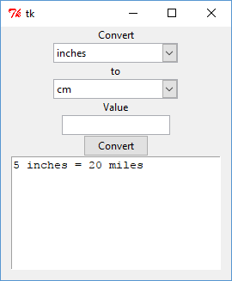
Button and Text
bt = ttk.Button(top, text="Convert")
bt.pack()
his = tkinter.Text(top, height=8, width=30)
his.insert(tkinter.END,"5 inches = 20 miles")
his.configure(state="disabled")
his.pack()
top.mainloop()
Notes:
Here is our BUTTON widget … again from TTK. First argument is the parent container. There are lots of parameters you can pass here … we’ll just pass the TEXT of the button CONVERT.
@1 What do we do to the widget after we create it? Yep … we pack it in. This is familiar by now.
@2 Let’s go ahead and add the output TEXT area. This time let’s use the TEXT component from TKINTER instead of TTK.
HIS short for history. We probably need a better name. First is the parent container.
Then the width and height of the text – in number of characters (8 rows and 30 columns).
@3 this is how we insert text into the TEXT area. The first parameter tells the widget where we want to insert the text. We’ll add the text onto the END of any existing text. The END value is defined in the TKINTER module. We just have to remember END instead of whatever the value really is.
@4 Here we disable the component. This prevents the user from typing into it.
@5 We pack it onto the bottom of the last component
@6 Run the program. And there we go. That’s all the widgets we need in our converter application! The layout isn’t great. We’ll work on that in the next lesson. But that’s all the widgets.

Slide 9
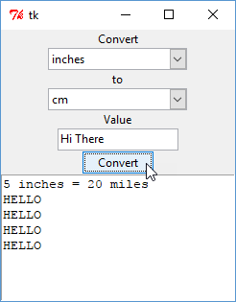
Button Click Event
import tkinter
from tkinter import ttk
def onClick():
print("I am here")
print("From:"+c1.get())
print("To:"+c2.get())
print("Value:"+inp.get())
his.configure(state="normal")
his.insert(tkinter.END,"\nHELLO")
his.configure(state="disabled")
top = tkinter.Tk()
...
bt = ttk.Button(top, text="Convert", command=onClick)
I am here
From:inches
To:cm
Value:Hi There
Notes:
We can even make it fully functional! All we need to do is attach a function to the CONVERT button.
@1 I’m going to call it ONCLICK. Maybe “DO CONVERSION” or “DO THIS WHEN COVERT IS CLICKED”. I like ONCLICK. Use your own favorite naming convention.
@2 When the button is pressed, let’s spew some messages to the console
@3 This is how we get the value of a widget. We called the FROM combobox c1. This line prints its selected value on the screen
@4 And the value of the TO combobox
@5 And the value of the TEXT entry
How do we add text to the TEXT area?
@6 First we need to re-enable it. We can’t change the text if it is disabled.
@7 Then we insert whatever text we want on the end. Here just a line-feed (SLASH N) and HELLO
@8 Don’t forget to disable the text area again to prevent the user from typing into it
@9 When we create our button we pass the “command” argument –
@10 a pointer to the function we want the button to call when it is clicked
@11 Now run the code. Put in “Hi There“ and click convert a few times.
Every time we press the button our ON CLICK function gets called. The function adds the HELLO line to the GUI, and it spews text to the console.
@12 Go back to the console and you’ll see the values from the widgets.
You now have all you need to make the converter functional! You know how to read widgets and write back to the text area when the button is pressed!

Slide 10
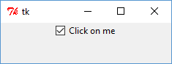
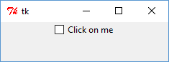
Checkbutton
import tkinter
from tkinter import ttk
top = tkinter.Tk()
# This object is shared by the widget and your own code
s = tkinter.IntVar()
s.set(1)
cb = ttk.Checkbutton(top, text="Click on me", variable=s)
cb.pack()
top.mainloop()
Try this in the REPL
Notes:
We only used a few types of widgets in our convert application. There are many, many more you can read about on your own. We’ll look at a couple more in this lesson.
You’ve interacted with checkboxes before. Click once to get the little check. Click again to make it go away.
In TKINTER this widget is called the CHECKBUTTON. It holds a Boolean value … true it is clicked or false it is not.
Some widgets manage the storage for their own state. The combobox, for example. You told it to SET its selected value. And later you asked it with GET to return its value.
But some widgets let you pass in a pointer to the storage for them to use. The checkbutton, for instance, expects you to create a storage object and tell it about it in the constructor.
There are different kinds of these storage objects you can use. @1 the IntVar holds an integer value. @2 you call SET on this object to give it a new value and GET to check the value. It functions just like a regular python number except it is an object you can share around the code.
@3 When you create the CHECKBUTTON, you tell it the variable to use. When the widget is drawn, it calls GET on the object to get the current value. When the user clicks on the button the widget calls SET on the object.
When you want the value of the checkbox you call GET on the storage object. You don’t have to ask the checkbutton for the state.

Slide 11
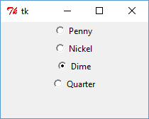
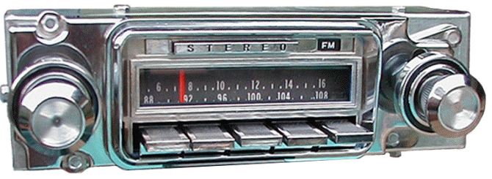
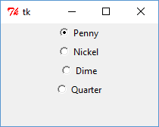
Radiobutton
import tkinter
from tkinter import ttk
top = tkinter.Tk()
s = tkinter.IntVar()
s.set(10)
rb1 = ttk.Radiobutton(top, text="Penny", variable=s, value=1)
rb1.pack()
rb2 = ttk.Radiobutton(top, text="Nickel", variable=s, value=5)
rb2.pack()
rb3 = ttk.Radiobutton(top, text="Dime", variable=s, value=10)
rb3.pack()
rb4 = ttk.Radiobutton(top, text="Quarter", variable=s, value=25)
rb4.pack()
top.mainloop()
Streams of bytes … two ways (into your program and out of your program)
Disks, consoles, sockets, keyboards, printers
Know how to talk streams and you can talk to anything
Initialization (constructor) is different. Use is the same.
Notes:
The RADIO BUTTON is like the CHECK BUTTON … it is either clicked or unclicked.
But RADIO BUTTONS come in groups, and only one button of the group can be selected. When you click on another button, the previous button is automatically deselected.
Yes, they are named for the buttons on these old car radios. You pushed in one a button and the needle moved to that station. When you pressed another button the first button popped back out and the needle moved to the new station.
The mechanism was totally mechanical. The force of your finger moved a rubber belt that moved the needle. The force also pushed the other button back out. My grandmom had one of these radios in her car. I was never strong enough to fully push the button in. The radio would end up between stations and I’d have to turn the tuning knob manually to get the rest of the way to the station.
Sorry.
@1 You need a storage variable like you used with checkbutton
@2 You pass this same variable to each radiobutton you want grouped together. This is the label on the button, and this is the value that this button represents.
@3 The next button is represented by a different value
@4 And the dime
@5 and the quarter
@6 When the shared variable has the value 10, as it does when the program starts, the corresponding button is selected.
@7 When you change the shared variable, say by clicking on another button, the value changes and the new button is selected.

Slide 12
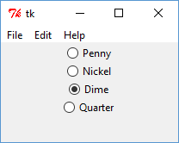
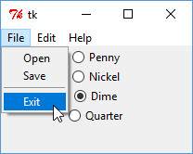
Menus
def ontest():
print "hello!"
menubar = tkinter.Menu(top)
filemenu = tkinter.Menu(menubar, tearoff=0)
filemenu.add_command(label="Open", command=ontest)
filemenu.add_command(label="Save", command=ontest)
filemenu.add_separator()
filemenu.add_command(label="Exit", command=top.quit)
menubar.add_cascade(label="File", menu=filemenu)
editmenu = tkinter.Menu(menubar, tearoff=0)
editmenu.add_command(label="Cut", command=ontest)
editmenu.add_command(label="Copy", command=ontest)
editmenu.add_command(label="Paste", command=ontest)
menubar.add_cascade(label="Edit", menu=editmenu)
helpmenu = tkinter.Menu(menubar, tearoff=0)
helpmenu.add_command(label="About", command=ontest)
menubar.add_cascade(label="Help", menu=helpmenu)
top.config(menu=menubar)
Notes:
Here is how you add a menu bar to the top of your GUI application.
@1 First I’ll create a callback function for testing. All it does is print a message on the console.
@2 This is how you create a new Menu. Like the other widgets, you must tell it what its parent container is.
But you don’t PACK it along with the rest of the widgets. Instead @3 way down here we tell the container “THIS IS YOUR MENU”.
@4 Now we create the submenus one by one. We’ll start with the “FILE” menu. It’s parent is the menubar we just created. And we set TEAROFF to 0. This means the menu can NOT be torn off and moved around. Most application do NOT have tearable menus. I’ll show you what one looks like shortly.
@5 Now a command in the menu. The “Open” command. It’s name in the menu and what to do when it is selected.
@6 The save command. We’ll give it the same testing callback.
@7 Here is how to make a separator line in the menu
@8 The EXIT command. Instead of pointing to our own callback, we’ll point it to a method of the top container. When this item is clicked it calls QUIT on the application frame, which closes the window.
@9 And we call ADD CASCADE to add one menu (our FILE menu) to another menu (the top menubar).
@10 Now for the EDIT menu
@11 We do the same … commands and then cascade it
@12 and the Help menu … same way
You can add submenus to menus and make a complicated menu system. I encourage you to experiment!

Slide 13
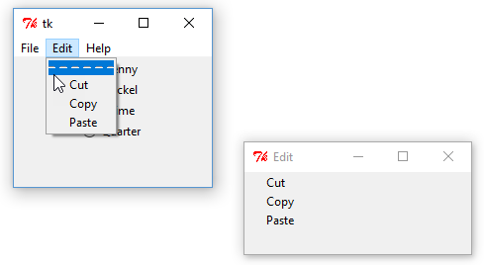
Menus
editmenu = tkinter.Menu(menubar, tearoff=1)
Notes:
This is what a tearable menu looks like. You tell the library that the menu is tearable.
Then you get a dotted line at the top – You know, tear on the dotted line.
Then you can drag the menu elsewhere on the screen. This keeps it open for quick access. And when you X it here it goes back into the menu from where it came.

Slide 14
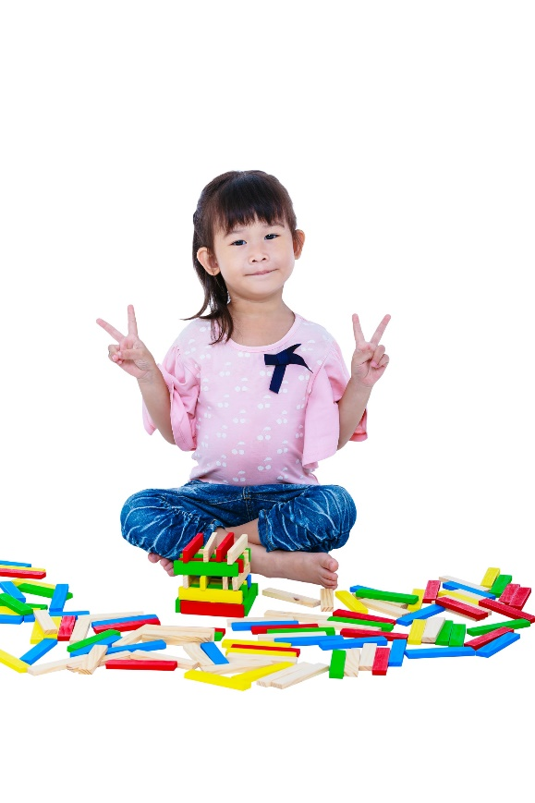
Tinkering
Finish the Converter example. Add the code to calculate the conversions.
Add a “Clear” button for the output area.
Research scrollbars for the output area.
Notes:
Here are some optional exercises for you … totally optional … nothing for you to turn in.
Finish up the converter application. Add the code to calculate the conversions.
Now add a CLEAR button to clear the history text area.
What happens when you have more than 8 lines in the text area? Do some research on adding scrollbars to the output area.
Send me email if you any questions or comments. I’ll see you next time.

